Slide 1


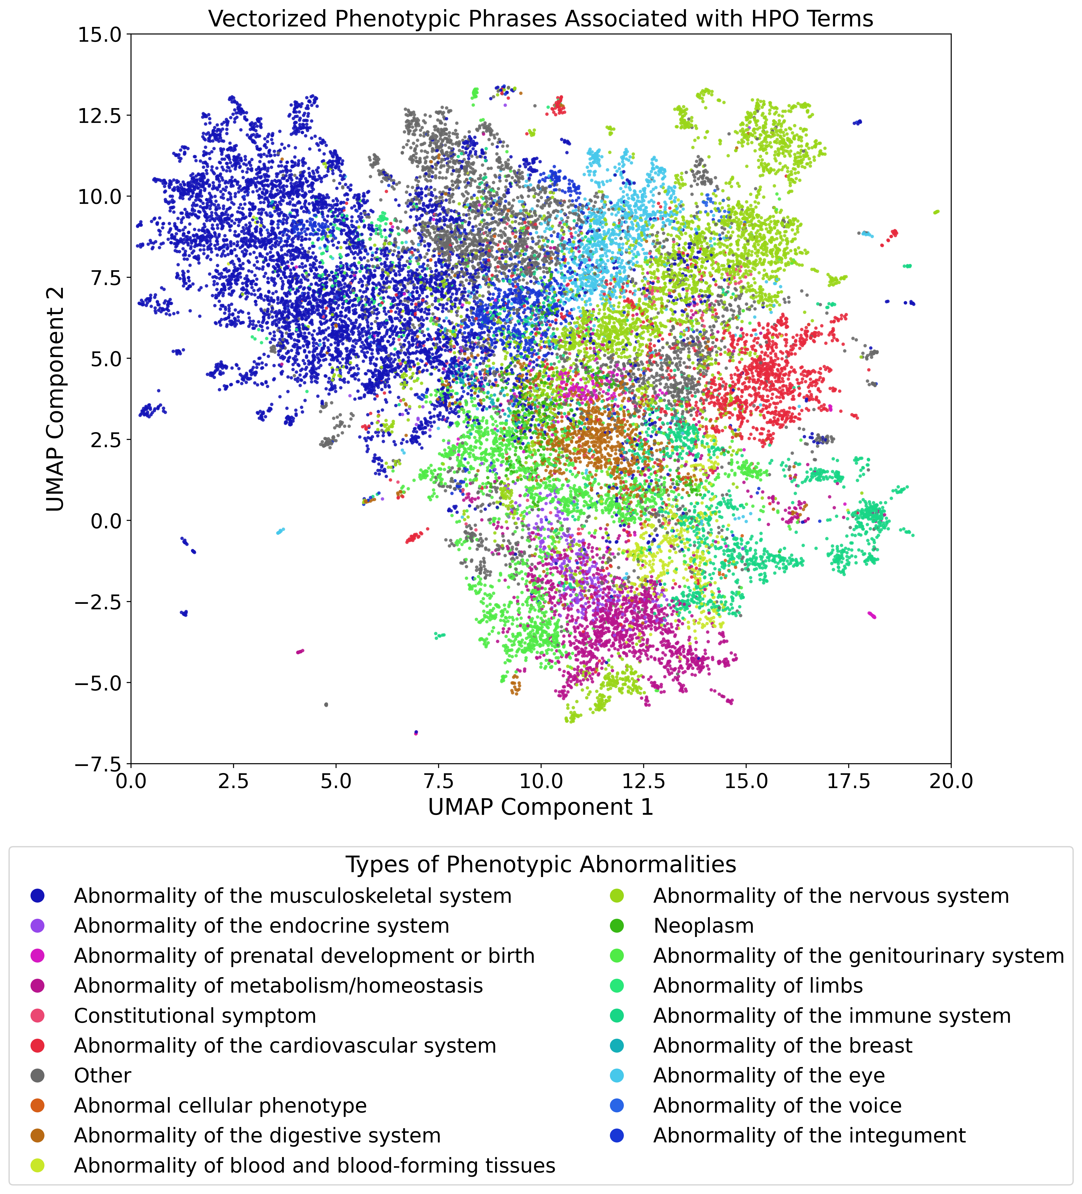
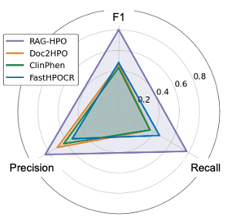

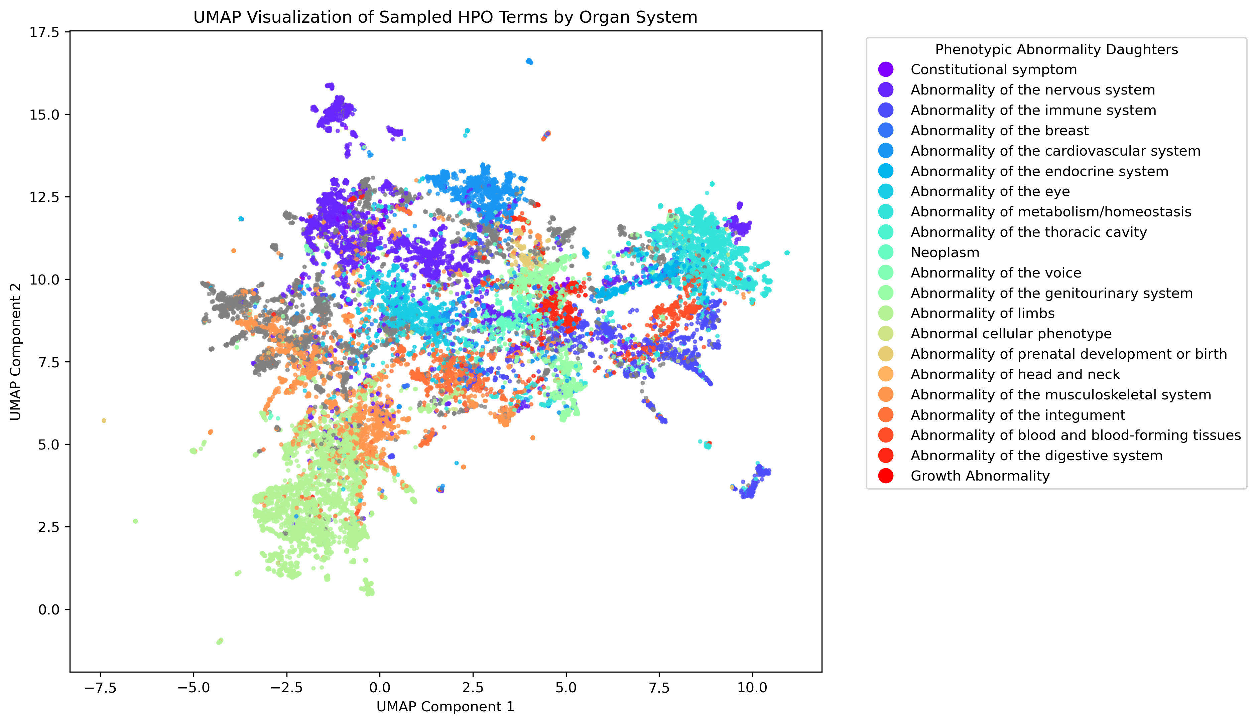


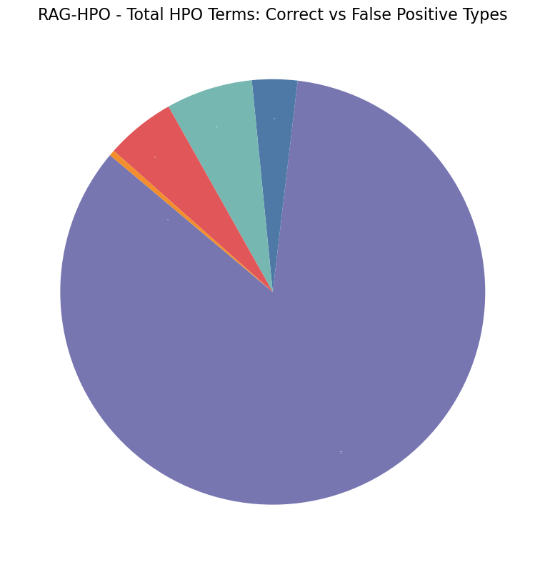
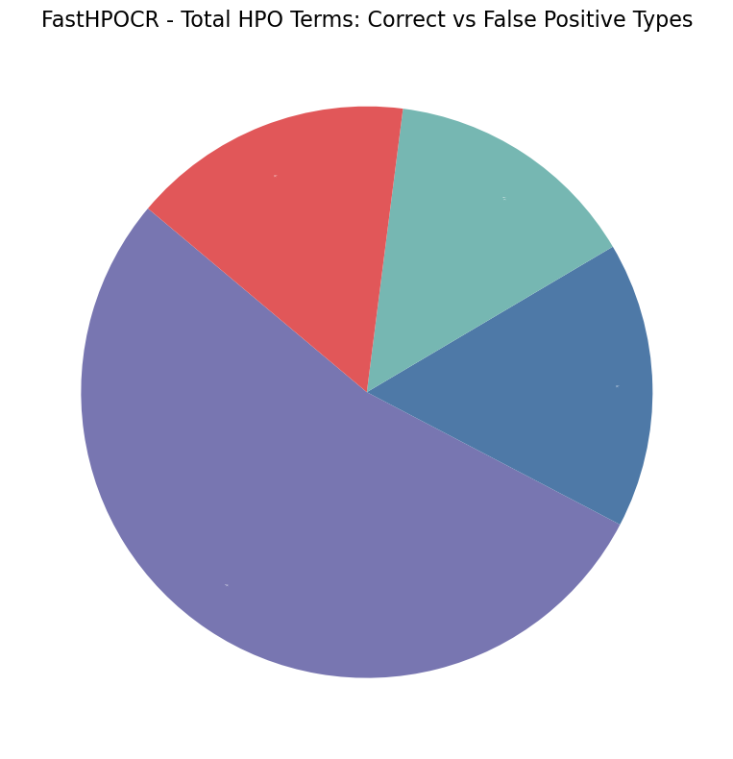

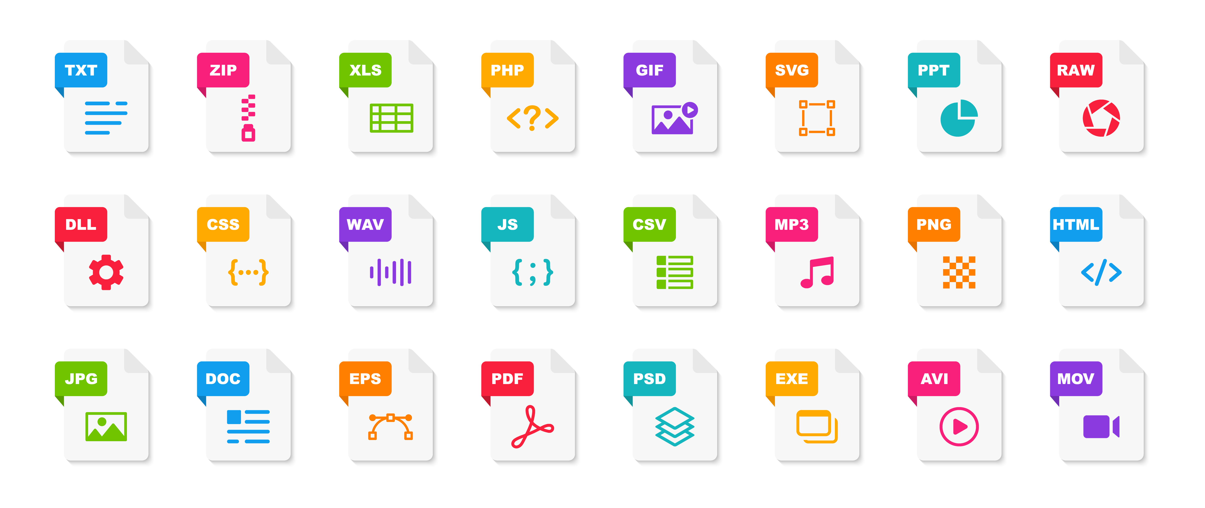

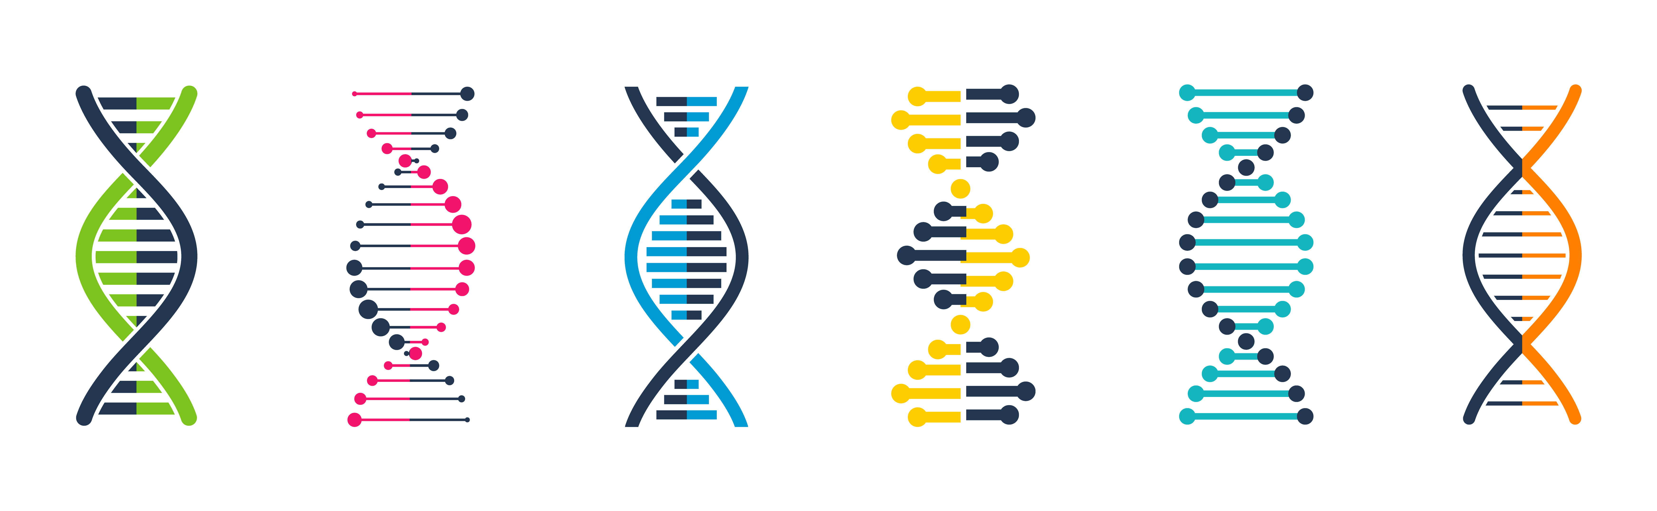

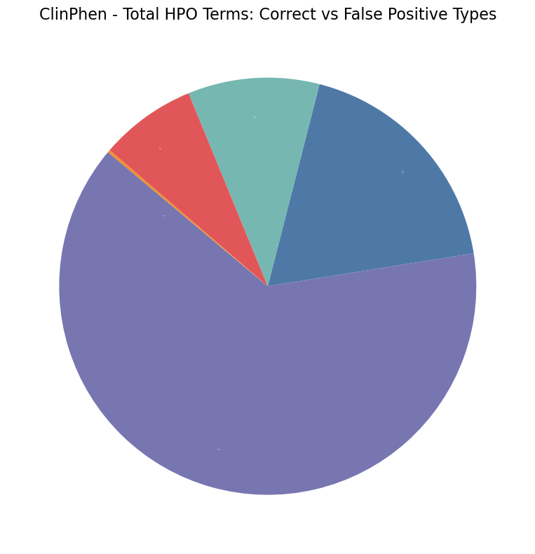
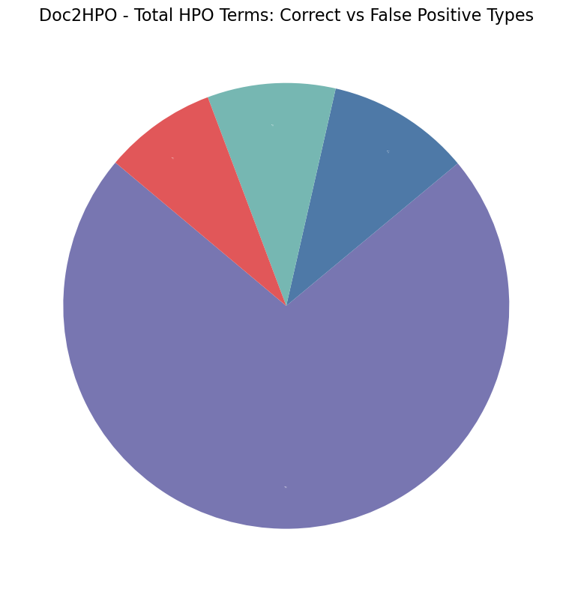
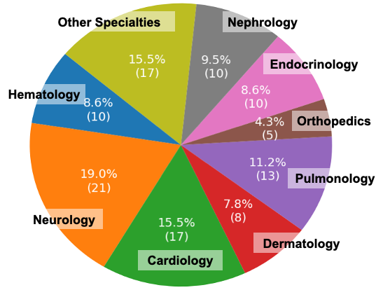

Retrieval Augmented Generation Greatly Improves the Ability of Large Language Models to Precisely Assign Human Phenotype Ontologies to Clinical Data
Brandon T. Garcia, Lauren Westerfield, Priya Yelemali, Nikhita Gogate, E. Andres Rivera-Munoz, Angad Jolly, Moez Dawood, Haowei Du, Jennifer E. Posey
Baylor College of Medicine, Houston TX
BACKGROUND
RESULTS
ITERATIVE IMPROVEMENT
Deep phenotyping is an in-depth analysis of a patient’s clinical presentation that is a key component of precision medicine and genomic research.
Dictionary-based, concept recognition tools like Doc2HPO and ClinPhen expedite deep phenotyping for research but often lack the contextual understanding needed to accurately capture all relevant phenotypes with patient records.
Large language models (LLMs) offer new opportunities to address these limitations through a better understanding of natural human language.
Retrieval-augmented generation (RAG) leverages LLMs and external reference documents to enhance the identification and accuracy of phenotype extraction from clinical notes, driving the next generation of deep phenotyping tools.
Analysis Tool | True Positive | False Positive | False Negative | Precision | Recall | F1 | Comparison to RAG-HPO
 |  |  |  |  |  |  | Precision | Recall | F1
RAG-HPO | 1368 | 257 | 424 | 0.84 | 0.76 | 0.80 | N/A | N/A | N/A
Doc2HPO | 643 | 251 | 1150 | 0.70 | 0.36 | 0.46 | **** | **** | ****
ClinPhen | 642 | 364 | 1150 | 0.63 | 0.36 | 0.43 | **** | **** | ****
FastHPOCR | 820 | 721 | 973 | 0.53 | 0.47 | 0.48 | **** | **** | ****
• RAG-HPO supports iterative improvement, staying current as the HPO database evolves.
• Designed to work with any LLM, RAG-HPO benefits from advances in language models without requiring redesign.
• Unlike static tools, RAG-HPO can be updated easily by end users or through new version releases.
• RAG-HPO’s vector database currently maps 54,000 phrases to HPO IDs, with the capacity to expand over time to improve precision
1
Term Specificity
2
3
Table 1. For our cohort of 116 published case reports, RAG-HPO had superior recall and precision compared to Doc2HPO, ClinPhen, and FastHPOCR. RAG-HPO was able to identify over twice as many accurate HPO terms per case than Doc2HPO or ClinPhen. FastHPOCR also identified significantly more HPO terms per case, but at the expense of increased false positives, leading to reduced precision. **** indicates p value < 0.0001
Figure 1. The Human Phenotype Ontology is a curated dictionary that provides standardized, hierarchical information about phenotypes in a human and machine-readable format.
HPO EXAMPLES:
HP:0011994 – Abnormal Atrial Septum Morphology
HP:0011995 – Atrial Septal Dilation
HP:0001631 – Atrial Septal Defect
Figure 4. RAG-HPO has significantly improved precision and recall compared to competitors. This radial graph demonstrates difference in precision, recall, and F1 scores of the HPO Analysis tools we analyzed. The most notable improvement is in recall, where RAG-HPO excels due to the language model’s ability to comprehend the broader context of clinical notes. This enhanced recall, coupled with high precision, leads to a superior F1 score.
DISCUSSION
Traditional HPO analysis software often misses relevant terms and requires extensive manual processing, highlighting the need for more advanced tools.
RAG-HPO integrates LLMs with a curated HPO database using retrieval-augmented generation (RAG) to enhance precision in identifying HPO terms.
The improved precision and recall of RAG-HPO streamline data mining and deep phenotyping for clinicians and researchers.
As LLMs and the HPO database evolve, RAG-HPO will continue to improve, offering even greater accuracy.
METHODS
Phenotype Extraction
A
B
5.3%
(86)
6.6%
(107)
3.4%
(56)
15.9%
(249)
14.5%
(223)
FUTURE DIRECTIONS
HPO vector database
0.4%
(7)
D
HPO Assignment
C
16.2%
(249)
84.2%
(1368)
54.3%
(823)
Term Specificity
Phenotype Analysis
Figure 2. RAG-HPO extracts phenotypic information and returns HPO terms. RAG-HPO works in two phases to assign HPO terms to free clinical text. In the first phase, the clinical information is parsed to the LLM for extraction of clinical abnormalities (A). The extracted phrases are then vectorized and compared to the HPO vector database using semantic similarity search (B). The top 20 most similar phrases are then returned to the LLM for each original phrase for assignment of HPO terms (C). Once all extract phrases are analyzed, the list of HPO terms is returned to the user for verification and downstream analysis (D).
RAG-HPO
FastHPOCR
7.5%
(75)
10.2%
(102)
18.5%
(185)
8.2%
(73)
9.3%
(83)
10.4%
(93)
Target Term
0.2%
(2)
False Positive Types:
Genotype-Phenotype Correlation
Direct Relative
Genomic Analysis
Figure 3. RAG-HPO performance was evaluated using a test cohort of 116 published cases. We compared the performance of RAG-HPO to that of several available tools including Doc2HPO, ClinPhen, and FastHPOCR. These cases were manually annotated by a certified genetic counselor and clinically trained students. We measured the precision, recall and combined F1 scores using the formulas below for each program to determine their performance in this dataset.
72.1%
(645)
Distant Relative
RAG-HPO is preparing for release onto Github and integration into analysis pipelines for rare genetic variant discovery and other clinical applications.
63.6%
(637)
Hallucination
ACKNOWLEDGEMENTS
ClinPhen
Doc2HPO
Unrelated
This work was supported by NHGRI HG011758 (GREGoR Consortium)
Figure 5. Analysis of Output reveals underlying relationships of false positives to true positives. We completed a deeper analysis of these HPO terms assigned by the HPO analysis tools to better understand their nature. HPO terms were categorized into distinct groups based on their relationship to the manually annotated standard: Direct relatives, distant relatives, hallucinations, and unrelated terms.
Contact Information
For inquiries about this project please contact:
Brandon Garcia: brandon.garcia@bcm.edu
Jennifer E. Posey: jennifer.posey@bcm.edu
Find us on github! https://github.com/PoseyPod
Precision = $\frac{True Positive}{\left(True Positive + False Positive\right)}$Recall = $\frac{True Positive }{(True Positive + False Negative) }$ F1 = $2 x \frac{(Precision x Recall)}{(Precision + Recall)}$

